Slide 1
Cross product & Joins
Notes:
Links: Link 1: Cross Product Video : https://www.youtube.com/watch?v=T1OfMa_J5ms
Link 2: Introduction of Joins : https://www.youtube.com/watch?v=CHdWcGhNWec

Slide 2
Cross Product
RollNumber | Name | Did
S1 | Ahmad | D1
S2 | Aliya | D1
S3 | Bushra | D2
S4 | Bilawal | D2
Select *
FROM Student AS s, Department AS d
RollNumber | Name | Did | DNumber | Dname
S1 | Ahmad | D1 | D1 | FOIT
S1 | Ahmad | D1 | D2 | FOEE
S2 | Aliya | D1 | D1 | FOIT
S2 | Aliya | D1 | D2 | FOEE
S3 | Bushra | D2 | D1 | FOIT
S3 | Bushra | D2 | D2 | FOEE
S4 | Bilawal | D2 | D1 | FOIT
S4 | Bilawal | D2 | D2 | FOEE
DNumber | Dname
D1 | FOIT
D2 | FOEE

Slide 3
Cross Product
RollNumber | Name | Did
S1 | Ahmad | D1
S2 | Aliya | D1
S3 | Bushra | D2
S4 | Bilawal | D2
Select *
FROM Student AS s, Department AS d
WHERE s.Did = d.DNumber;
DNumber | Dname
D1 | FOIT
D2 | FOEE
RollNumber | Name | Did | DNumber | Dname
S1 | Ahmad | D1 | D1 | FOIT
S2 | Aliya | D1 | D1 | FOIT
S3 | Bushra | D2 | D2 | FOEE
S4 | Bilawal | D2 | D2 | FOEE

Slide 4
Cross Product
RollNumber | Name | Did
S1 | Ahmad | D1
S2 | Aliya | D1
S3 | Bushra | D2
S4 | Bilawal | D2
Select *
FROM Department AS d, Student AS s
WHERE s.Did = d.DNumber;
DNumber | Dname
D1 | FOIT
D2 | FOEE
DNumber | Dname | RollNumber | Name | Did
D1 | FOIT | S1 | Ahmad | D1
D1 | FOIT | S2 | Aliya | D1
D2 | FOEE | S3 | Bushra | D2
D2 | FOEE | S4 | Bilawal | D2

Slide 5
Cross Product with selected attributes
Select Student.RollNumber, Student.Name, department.Dname
From Student, Department
Where Student.Did = Department.Dnumber ;
Roll Number | Name | Dname
S1 | Ahmad | FOIT
S2 | Aliya | FOIT
S3 | Bushra | FOEE
S4 | Bilawal | FOEE

Slide 6
Cross Product with condition
Select Student.RollNumber, Student.Name, Department.Dname
From Student, Department
Where Student.Did = Department.Dnumber AND department.Dname = ‘Foit’;
RollNumber | Name | Dname
S1 | Ahmad | FOIT
S2 | Aliya | FOIT

Slide 7
Same Concept with Inner Join
Select Student.RollNumber, Student.Name, Department.Dname
From Student inner join Department on Student.Did = Department.Dnumber
Where department.Dname = ‘Foit’;
RollNumber | Name | Dname
S1 | Ahmad | FOIT
S2 | Aliya | FOIT

Slide 8
Cross Product of three Tables
Student
Enrollment
id | Name | GPA
s1 | miraal | 3.33
s2 | Kashaan | 3.67
s3 | Farhan | 3.09
sID | cID | Grade
s1 | DB | A
s1 | ITC | A-
s1 | LT | A
s2 | ITC | B+
s3 | ITC | B
s3 | LT | A+
course
id | CName | CrdtHrs
c1 | DB | 4
c2 | ITC | 4
c3 | LT | 3

Slide 9
Cross Product of three Tables
SELECT *
FROM Student AS s, Enrollment AS e, Course AS c
WHERE s.id = e.sID AND c.id = e.cID;
id | Name | GPA
s1 | miraal | 3.33
s2 | Kashaan | 3.67
s3 | Farhan | 3.09
sID | cID | Grade
s1 | C1 | A
s1 | C2 | A-
s1 | C3 | A
s2 | C2 | B+
s3 | C2 | B
s3 | C3 | A+
id | CName | CrdtHrs
C1 | DB | 4
C2 | ITC | 4
C3 | LT | 3

Slide 10
Cross Product of three Tables
id | Name | GPA | sID | cID | Grade | id | CName | CrdtHrs
s1 | Miraal | 3.33 | s1 | C1 | A | C1 | DB | 4
s1 | miraal | 3.33 | s1 | C2 | A- | C2 | ITC | 4
s1 | miraal | 3.33 | s1 | C3 | A | C3 | LT | 3
s2 | Kashaan | 3.67 | s2 | C2 | B+ | C2 | ITC | 4
s3 | Farhan | 3.67 | s3 | C2 | B | C2 | ITC | 4
s3 | Farhan | 3.67 | s3 | C3 | A+ | C3 | LT | 3
SELECT *
FROM Student AS s, Enrollment AS e, Course AS c
WHERE s.id = e.sID AND c.id = e.cID;
Student
id | Name | GPA
s1 | miraal | 3.33
s2 | Kashaan | 3.67
s3 | Farhan | 3.09
Enrollment
sID | cID | Grade
s1 | C1 | A
s1 | C2 | A-
s1 | C3 | A
s2 | C2 | B+
s3 | C2 | B
s3 | C3 | A+
course
id | CName | CrdtHrs
C1 | DB | 4
C2 | ITC | 4
C3 | LT | 3

Slide 11
Types of Joins
Inner Join
  Natural Join
Outer Join
  Right Outer Join
  Left Outer Join
  Full Outer Join

Slide 12
Outer join = ??9 rows
Select fname,dname
From employee full outer join department on dno= dnumber;
John research
Franklin research
Alicia admin
JEnnifer NULL
..
James NULL
NULL IT

Slide 13
JOINS
A JOIN clause is used to combine rows from two or more tables, based on a related column between them.
(INNER) JOIN: Returns records that have matching values in both tables
LEFT (OUTER) JOIN: Returns all records from the left table, and the matched records from the right table
RIGHT (OUTER) JOIN: Returns all records from the right table, and the matched records from the left table
FULL (OUTER) JOIN: Returns all records when there is a match in either left or right table

Slide 14
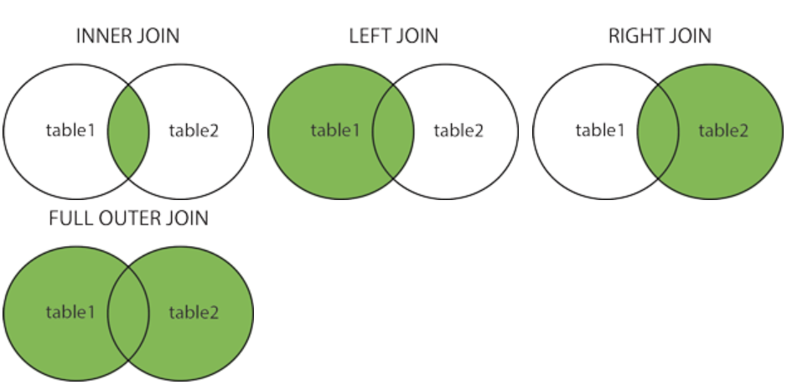

Slide 15
JOINS
Show name of all student along with their department information only if they are enrolled in department.
RollNumber | Name | Did
S1 | Ahmad | D1
S2 | Aliya | D1
S3 | Bushra | D2
S4 | Bilawal | D2
S5 | Sameena | NULL
S6 | Seher | NULL
DNumber | Dname
D1 | FOIT
D2 | FOEE
D3 | FOSS

Slide 16
Result
RollNumber | Name | Did
S1 | Ahmad | D1
S2 | Aliya | D1
S3 | Bushra | D2
S4 | Bilawal | D2
S5 | Sameena | NULL
S6 | Seher | NULL
DNumber | Dname
D1 | FOIT
D2 | FOEE
D3 | FOSS

Slide 17
JOINS
Show name of student along with their department information. Show all departments whether any student is enrolled in department or not. (left/Right outer join)
Show information of all students with information of all department whether any student has enrolled in the department or not and vice versa. (FULL OUTER JOIN)
RollNumber | Name | Did
S1 | Ahmad | D1
S2 | Aliya | D1
S3 | Bushra | D2
S4 | Bilawal | D2
S5 | Sameena | NULL
S6 | Seher | NULL
DNumber | Dname
D1 | FOIT
D2 | FOEE
D3 | FOSS

Slide 18
Syntax : INNER JOIN
SELECT s.RollNumber, s.Name , d.Dname
FROM Student AS s
INNER JOIN Department AS d ON s.Did=D.DNumber;
Student
Department
RollNumber | Name | Did
S1 | Ahmad | D1
S2 | Aliya | D1
S3 | Bushra | D2
S4 | Bilawal | D2
S5 | Sameena | NULL
S6 | Seher | NULL
DNumber | Dname
D1 | FOIT
D2 | FOEE
D3 | FOSS

Slide 19
Output: INNER JOIN
SELECT s.RollNumber, s.Name , d.Dname
FROM Student AS s
INNER JOIN Department AS d ON s.Did=D.DNumber;
Student Inner Join Department
RollNumber | Name | Dname
S1 | Ahmad | FOIT
S2 | Aliya | FOIT
S3 | Bushra | FOEE
S4 | Bilawal | FOEE

Slide 20
Syntax : LEFT OUTER JOIN
SELECT s.RollNumber, s.Name , d.Dname
FROM Student AS s Left JOIN Department AS d ON s.Did=D.DNumber;
Student
Department
RollNumber | Name | Did
S1 | Ahmad | D1
S2 | Aliya | D1
S3 | Bushra | D2
S4 | Bilawal | D2
S5 | Sameena | NULL
S6 | Seher | NULL
DNumber | Dname
D1 | FOIT
D2 | FOEE
D3 | FOSS

Slide 21
Output: LEFT OUTER JOIN
SELECT s.RollNumber, s.Name , d.Dname
FROM Student AS s
LEFT JOIN Department AS d ON s.Did=D.DNumber;
Student Left Join Department
RollNumber | Name | Dname
S1 | Ahmad | FOIT
S2 | Aliya | FOIT
S3 | Bushra | FOEE
S4 | Bilawal | FOEE
S5 | Sameena | NULL
S6 | Seher | NULL

Slide 22
Syntax : RIGHT OUTER JOIN
SELECT s.RollNumber, s.Name , d.Dname
FROM Student AS s
RIGHT JOIN Department AS d ON s.Did=D.DNumber;
Student
RollNumber | Name | Did
S1 | Ahmad | D1
S2 | Aliya | D1
S3 | Bushra | D2
S4 | Bilawal | D2
S5 | Sameena | NULL
S6 | Seher | NULL
Department
Did | Dname
D1 | FOIT
D2 | FOEE
D3 | FOSS

Slide 23
Output: RIGHT OUTER JOIN
SELECT s.RollNumber, s.Name , d.Dname
FROM Student AS s
RIGHT JOIN Department AS d ON s.Did=D.DNumber;
Student RIGHT JOIN Department
RollNumber | Name | Dname
S1 | Ahmad | FOIT
S2 | Aliya | FOIT
S3 | Bushra | FOEE
S4 | Bilawal | FOEE
NULL | NULL | FOSS

Slide 24
Syntax : FULL OUTER JOIN
SELECT s.RollNumber, s.Name , d.Dname
FROM Student AS s
FULL OUTER JOIN Department AS d ON s.Did=D.DNumber;
Student
Department
RollNumber | Name | Did
S1 | Ahmad | D1
S2 | Aliya | D1
S3 | Bushra | D2
S4 | Bilawal | D2
S5 | Sameena | NULL
S6 | Seher | NULL
DNumber | Dname
D1 | FOIT
D2 | FOEE
D3 | FOSS

Slide 25
Output: FULL OUTER JOIN
SELECT s.RollNumber, s.Name , d.Dname
FROM Student AS s
FULL OUTER JOIN JOIN Department AS d ON s.Did=D.DNumber;
Student FULL OUTER JOIN Department
RollNumber | Name | Dname
S1 | Ahmad | FOIT
S2 | Aliya | FOIT
S3 | Bushra | FOEE
S4 | Bilawal | FOEE
S5 | Sameena | NULL
S6 | Seher | NULL
NULL | NULL | FOSS

Slide 26
Self Join
Show name of employee with the name of his supervisor
Employee
ssn | name | address | salary | Super_ssn

Slide 27
Self Join
Show name of employee with the name of his supervisor
SELECT empl.name, super.name
FROM EMPLOYEE empl, EMPLOYEE Super
WHERE empl.super_ssn = super.ssn;
empl
ssn | name | address | salary | Super_ssn
Super
ssn | name | address | salary | Super_ssn

Slide 28
Natural Join
The SQL NATURAL JOIN is a type of JOIN and is structured in such a way that, columns with the same name of associated tables will appear once only.
Natural Join: Guidelines
- The associated tables one identically named column.
- The columns must be the same data type.
- Don’t use ON clause in a natural join.

Slide 29
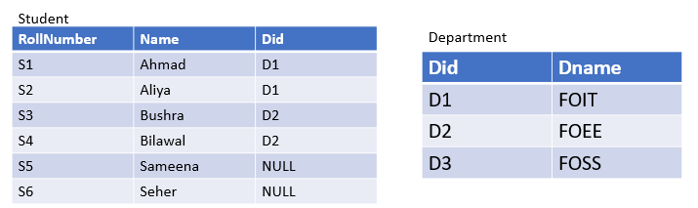
Natural Join
Example
Select *
From student natural join department;
Note: if we would have used join instead of natural join there would have been 5 columns in result. Secondly, we had to give the condition for join too.
Rollnumber | Name | Did | Dname
S1 | Ahmad | D1 | FOIT
S2 | Aliya | D1 | FOIT
S3 | Bushra | D2 | FOEE
S4 | Bilawal | D2 | FOEE

Slide 30
Practice Queries
Show names of all employee with their dependent names whether they have any dependent or not.
Show all project names along with the employee names working on it whether there are some employees working on it or not.
3. Show department names along with their locations for those departments whose location has ‘ton’ in its name.
4. Show all employee names with their department names whether they are working in any department or not .
5 Show a report which tells all which employee is working on which project. Which employee is not working on project and which project is not being worked on.
6. Show names of all managers with their dependent names whether they have any dependent or not.

Slide 31
Clause: using
If several columns have the same names but the datatypes do not match, the NATURAL JOIN clause can be modified with the USING clause to specify the columns that should be used for JOIN.
NATURAL JOIN and USING Clause are mutually exclusive.
NATURAL JOIN uses all the columns with matching names and datatypes to join the tables.

Slide 32
Example
Select *
From student join department using (did) ;
Rollnumber | Name | Did | Dname | Did
S1 | Ahmad | D1 | FOIT | D1
S2 | Aliya | D1 | FOIT | D1
S3 | Bushra | D2 | FOEE | D2
S4 | Bilawal | D2 | FOEE | D2

Slide 33
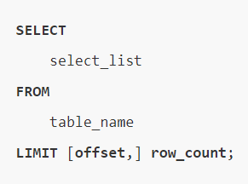
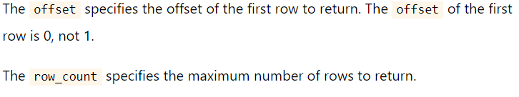
MySQL LIMIT clause
The LIMIT clause is used in the query to constraint the number of rows to return.

Slide 34
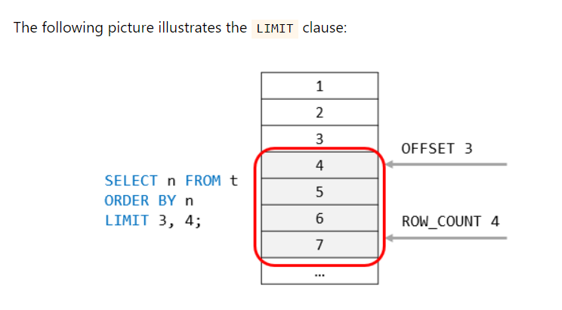
Example

Slide 35
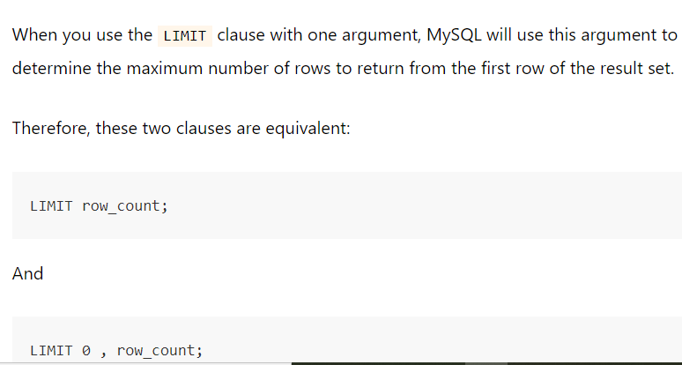

Slide 36
Query Examples
Show customer name who have the highest salary.
select fname
From employee
Order by salary desc
Limit 0,1

Slide 37
Show customer name who have the second highest salary.
select fname
From employee
Order by salary desc
Limit 1,1

Slide 38
Show top five customer who have the most salary.
select fname
From employee
Order by salary desc
Limit 0, 5

